Slide 1
Making the Drop
Exploratory Data Analysis

Slide 2
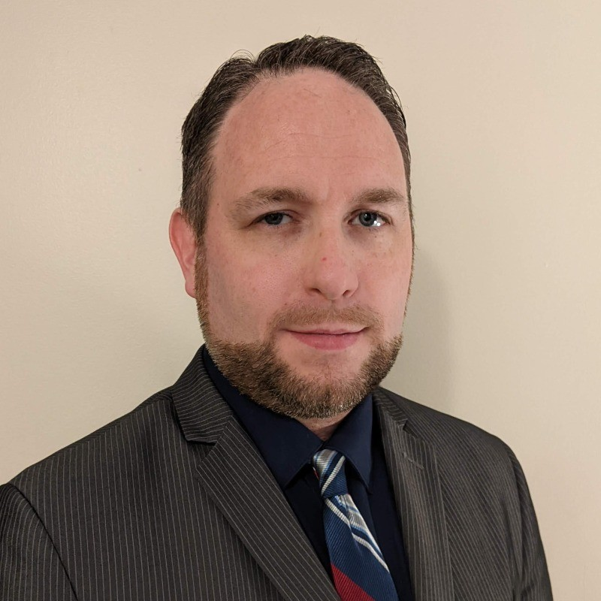
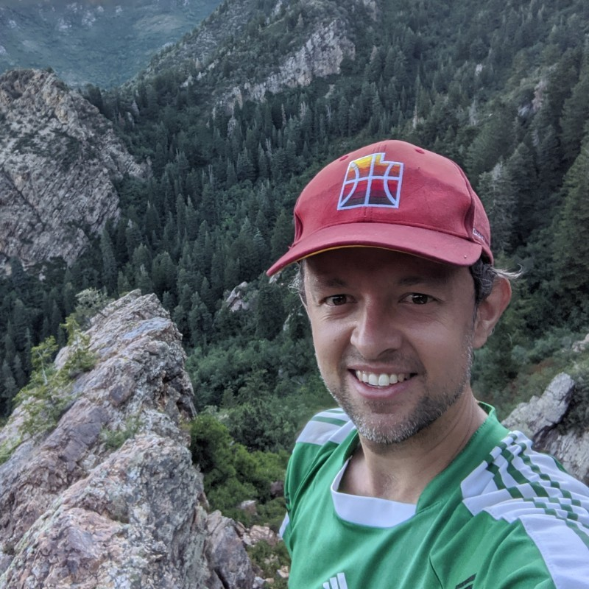
Surf Coaches
Jake Young
Donor Network of AZ
Data Analytics & Systems Lead
Brandon McKown
New England
Donor Services
Manager, Business Intellig

Slide 3
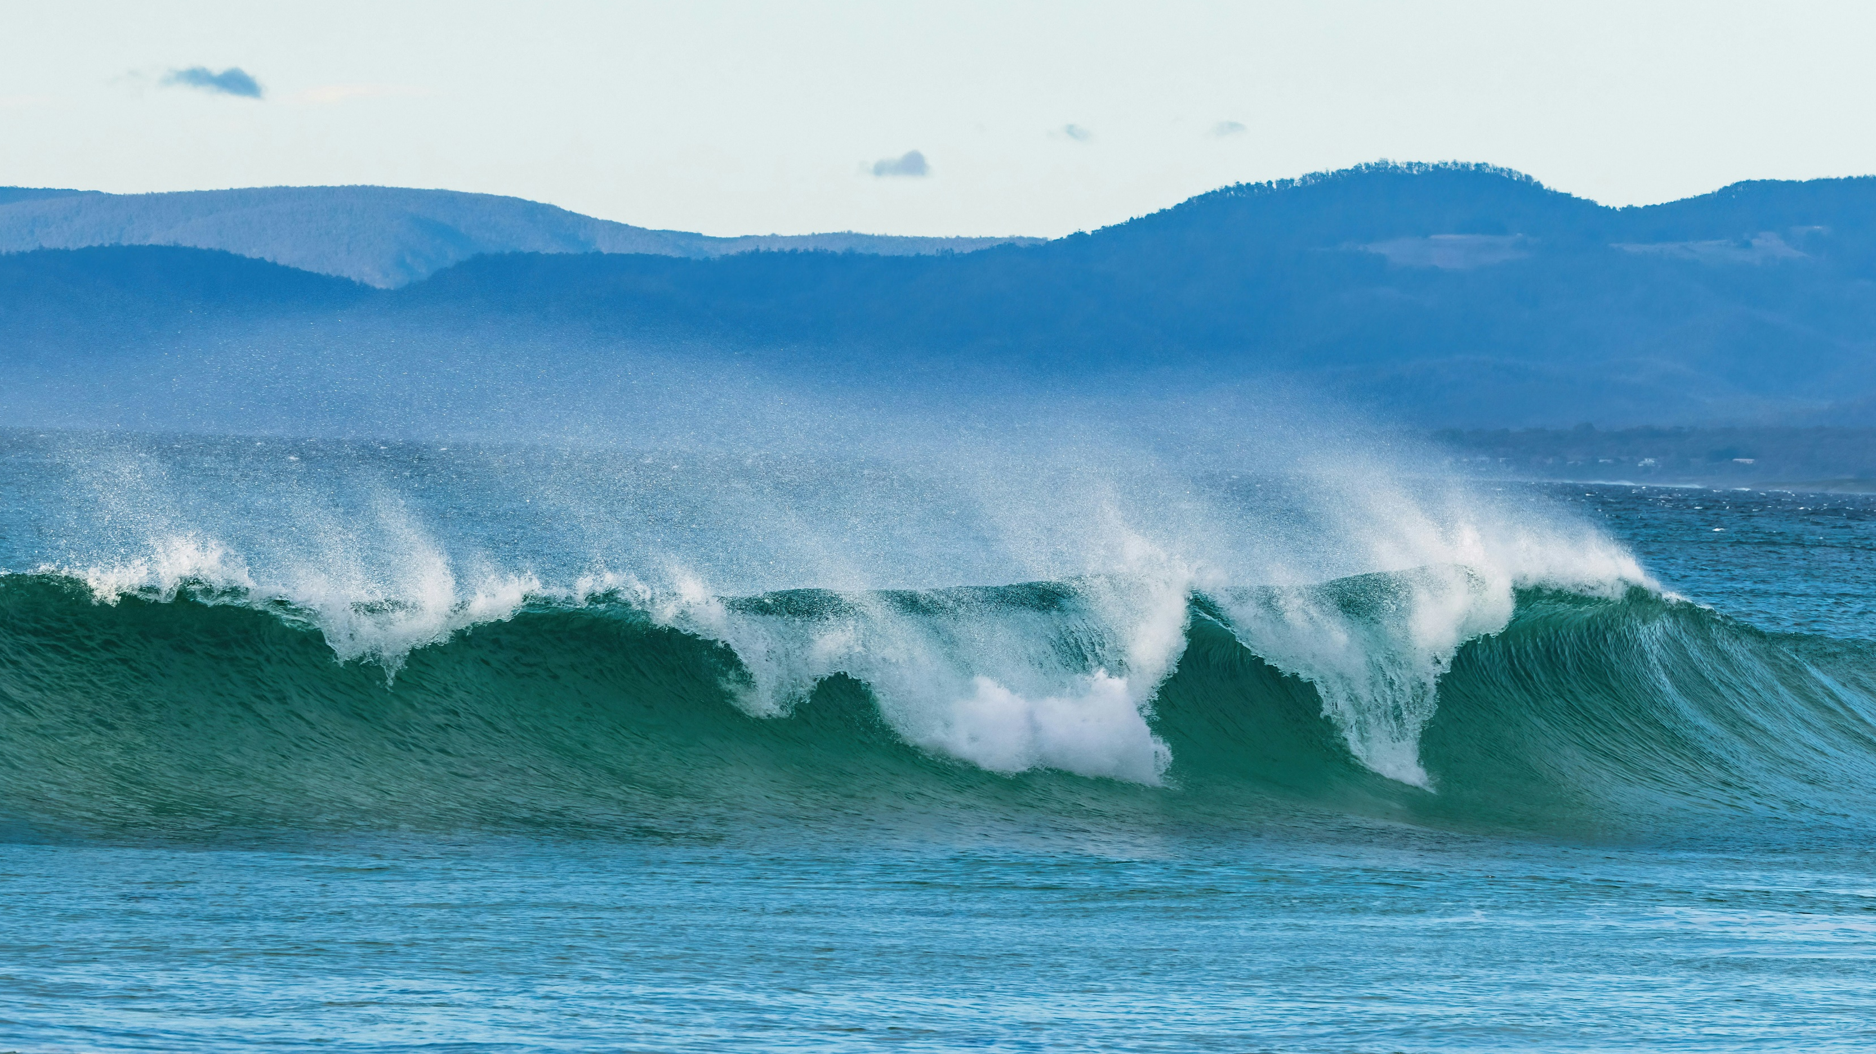

Sneaker Wave
Finding
the Line
They asked the C-Suite for explanations and solutions, but each member provided a different answer…
Ebbing Tide
They are bothered by a three-year declining trend in organ donor authorization rates for non-registered patients.
CEO Call
Harshing Your Mellow
Your phone buzzes—it’s the CEO of your OPO!
You're on a beach, enjoying your PTO.

Slide 4
Sketched Out
Cold Water: Water’s way too cold, bro, I forgot my thicker wetsuit.
“Attitudes are changing, fewer families are receptive to organ donation.”
No Stoke: Dude, I’m not feelin’ those waves, the stoke isn’t there ya know?
“A specific region in our DSA has significantly lower authorization rates.”
Spoiled Surf: Man, so many waves now, I’m getting spoiled and losing my edge.
“We’re having more discussions, but relatively fewer authorizations.”

Slide 5

Wave Scoping
CEO's Request: Clear path for improvement.
Focus: What can your OPO control to increase authorization rates?
Key Question: What have been the two primary features of discussions that are authorized?

Slide 6
The Chop
Fields | Description
referral_id | Unique identifier of the hospital referral.
referral_date | Date and time the referral was received.
hospital_region | Numeric value representing the region of the referral’s hospital within the OPO’s designated service area.
patient_age_yrs | Age, in years, of the referred patient.
patient_sex | Sex of the referred patient.
race_category | Race of the referred patient.
cause_of_death | Cause of Death of the referred patient.
mechanism_of_death | Mechanism of Death of the referred patient.
timely_referral | Indicator of if the referral was received prior to brain death testing or a “Comfort Measures Only” (CMO) discussion.
staff_arrived_on_site_date | Date and time the first OPO staff arrived on site for this referral.
unplanned_mention_of_donation_by_hospital | Indicator of if hospital staff mentioned organ donation to the patient’s next-of-kin/family before the OPO staff was able to do so.
approach_date | Date and time of the first discussion by OPO staff with next-of-kin regarding organ donation.
phone_approach | Indicator of if the discussion was made by OPO staff with the next-of-kin via phone call.
preliminary_discussion_of_donation | A mention by OPO staff to the next-of-kin/family of the possibility of organ donation, prior to a full discussion.
type_of_legal_next_of_kin_approached | The role of the legal next-of-kin in relation the referred patient.
type_of_donation_discussed | The manner of organ recovery primarily discussed (i.e., Donation after Brain Death or Donation after Cardiac Death).
type_of_staff_approaching | Role of the OPO staff leading the discussion (i.e., FSC = Family Services Coordinator, IHC = In-House Coordinator).
staff_approaching_name | Name of the OPO staff leading the discussion.
effective_request_plan_occurred | If, prior to a discussion, a plan for introducing the discussion was collaboratively made with hospital staff and that plan was followed.
final_decision_date | Date and time the next-of-kin gave a final declination or consent for organ donation.
authorized | Indicator of if the discussion resulted in a yes or no for organ donation.
~2,000 referrals of non-registered patients w/ organ donation discussions…
[Where to get dataset]

Slide 7
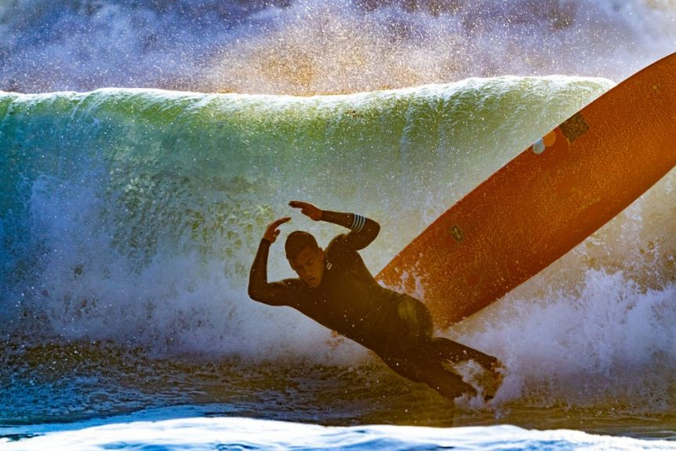
The Beasts
Glass or Junk: Data Quality Issues
Keepers or Close-Outs: What data are valuable (keepers) and what are useless (close-outs)?
Knee-Highs to Breakthroughs: How can small insights add up to a big find in answering the CEO’s question?

Slide 8


Choose Your Plank
Excel
Power BI
Tableau
Qlik
Python
R
Dundas
…

Slide 9
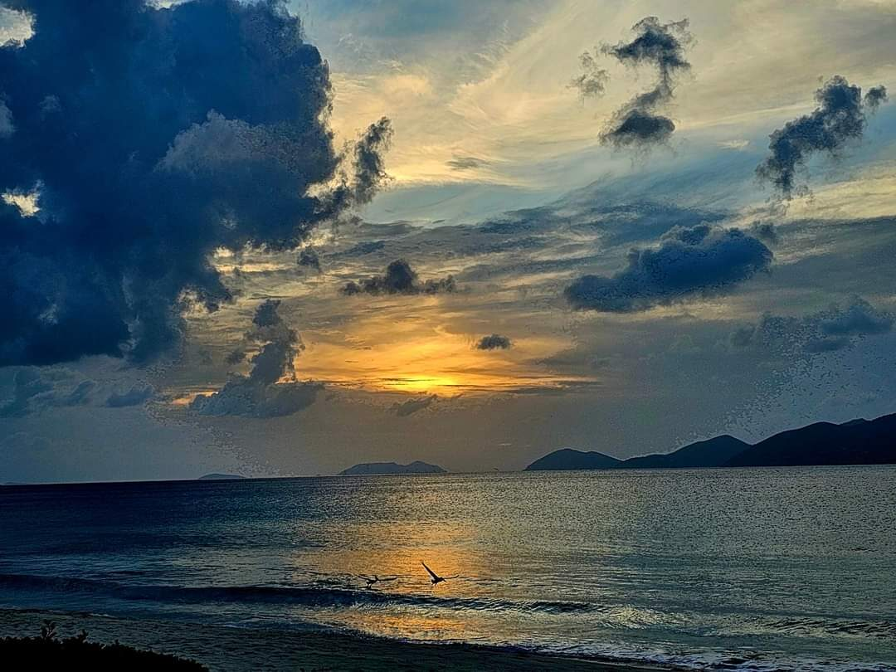
Tomorrow’s Forecast
Catch the Wave: Group Investigation & Analysis Activity 1115-1230
Work with your team to find the answer. If you have time, build a quick visual (in any tool) to show what you have found…
Impact Zone: Analytics to Action
1515-1545
Brief the CEO & C-Suite on your findings…
3 Minute (or less) Presentation
Awards for
Correct (or Closest) Answer
Best Visual
Most Persuasive Presentation
[…]
Go Shred It!
(Good Luck)

Slide 10
Jake’s Slides
Jake’s Slides
Jake’s Slides
Jake’s Slides

